Slide 1
Research Progress of DIC & DLD
Aug 6, 2018
Xingyu Su

Slide 2
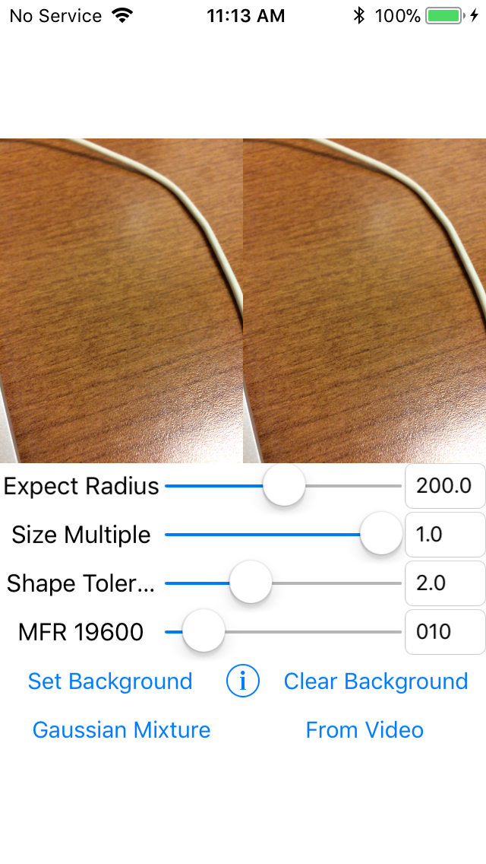
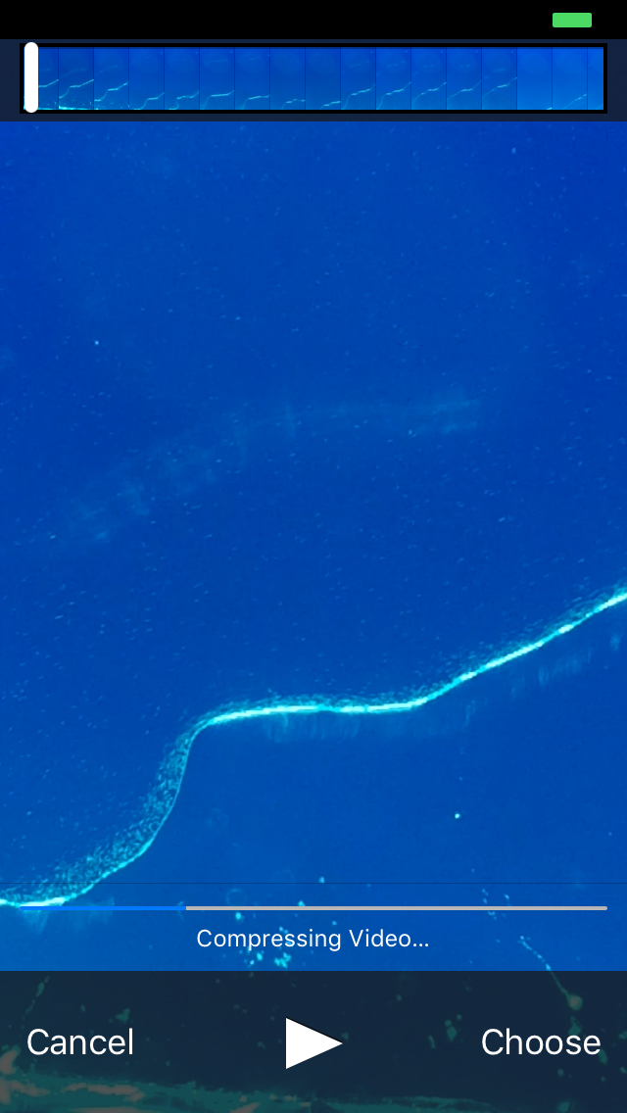
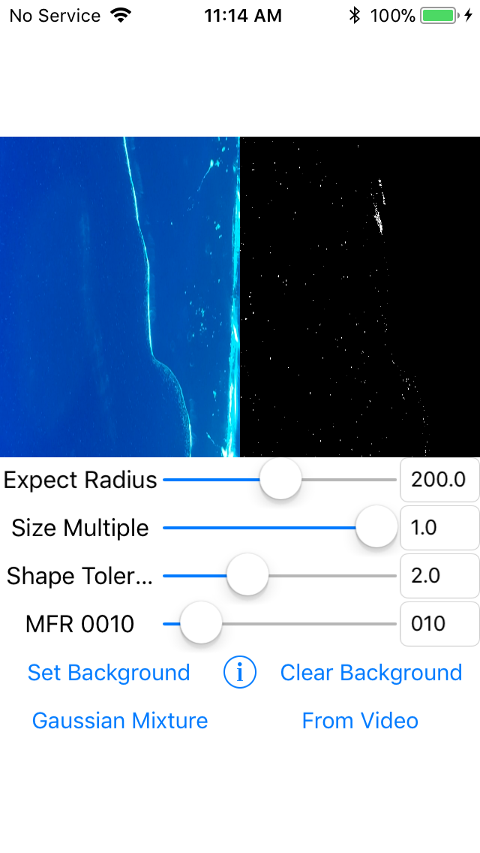
iOS Droplet Counter
Click button to be “From Video” Mode
Choose video
Detecting with video
Notes:
Add video part for iOS Droplet Counter

Slide 3
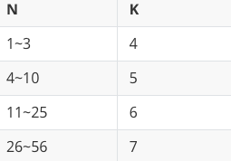
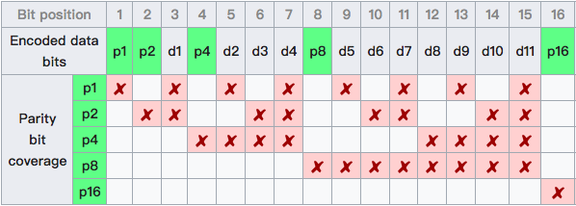
Droplet Length Decoder
Hamming Error Correct Code
Data bits: N
Parity bits: K
Condition: 2^(K-1) >= N + K + 1
Notes:
Implemented Hamming Code for Droplet Length Decoder

Slide 4
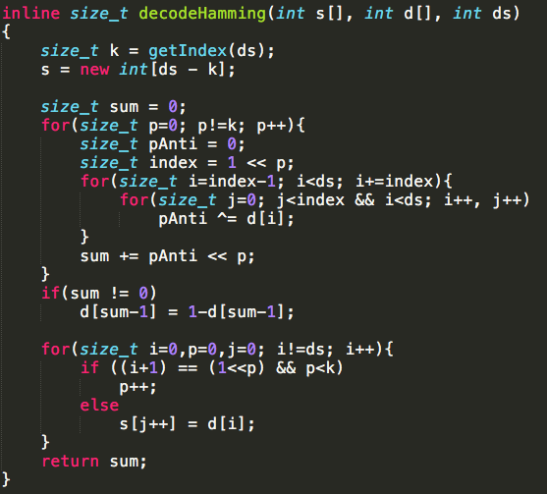


Droplet Length Decoder

Slide 5
Droplet Length Decoder
Implement serial port writer
Modify code structure
Tree of code (~ 850 lines)
FastCamera.cpp
FastCamera.h
LengthAnalyzer.cpp
LengthAnalyzer.h
SerialPort.cpp
SerialPort.h
utils.h
Notes:
So the job before experiment is almost done, I’m waiting Steven’s video for testing.

Slide 6
Problems
iOS Droplet Counter
Add video part
Modify conflicts between photo selecting and video selecting
Study literature for better tracking algorithm
Droplet Length Decoder
Add windows serial port writer (send TTL signal by Arduino)
Add Hamming decoder
Modify code to be elegant

Slide 7
Next Week Plan
iOS Droplet Counter
Complete tracking and counting
Wait Geonsoo’s channel and test
Prepare for experiment
Droplet Length Decoder
Wait Steven’s video and test
Debug and improve
Prepare for experiment

Slide 8
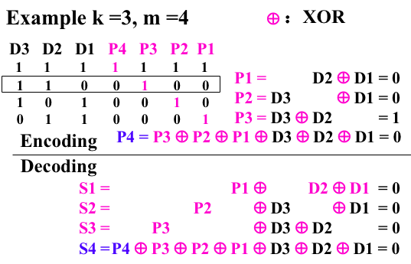
Appendix
No error:
S4 S3 S2 S1 = 0 0 0 0
S4~S1 = 0000
D1 error:
S4 S3 S2 S1 = 1 0 1 1
D2 error:
S4 S3 S2 S1 = 1 1 0 1
D3 error:
S4 S3 S2 S1 = 1 1 0 1
One of S3~S1=0,S4=1
P2 D1 error:
S4 S3 S2 S1 = 0 0 0 1
S3~S1 != 000, S4=0

Slide 9
Thanks
Notes:
Thanks all of you for watching and listening.

